Slide 1
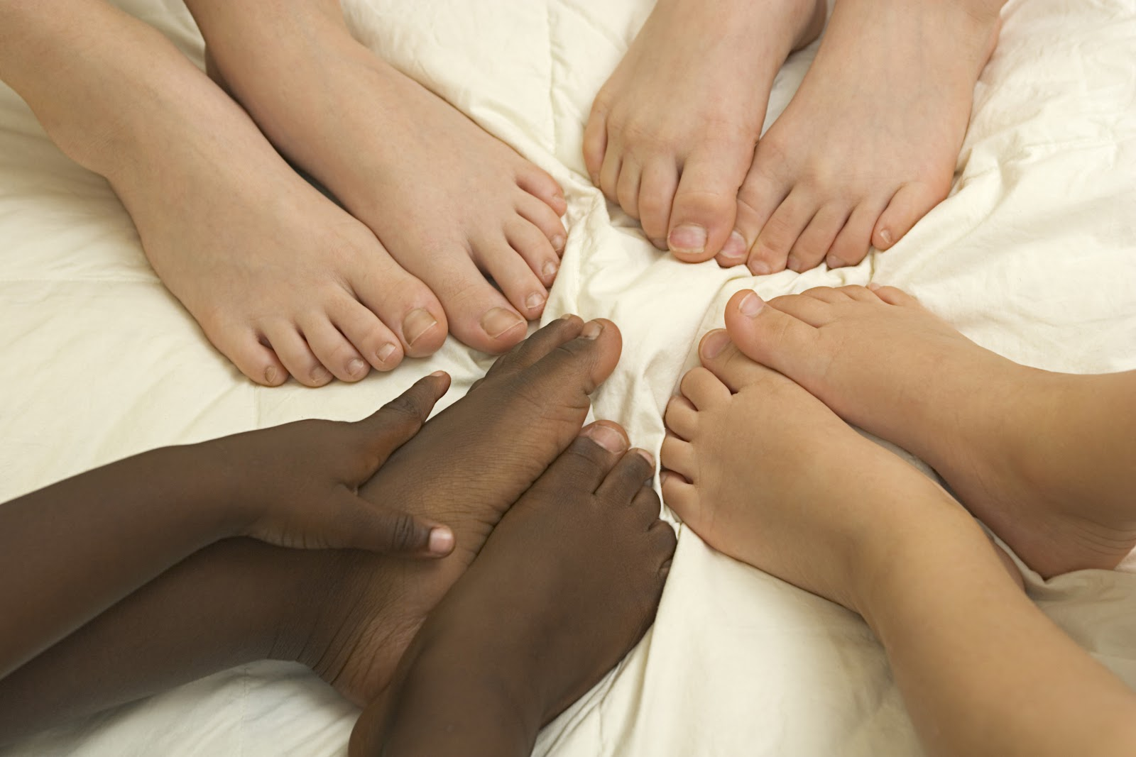
We have kind
legs and feet.

Slide 2

How many legs
do you have?

Slide 3
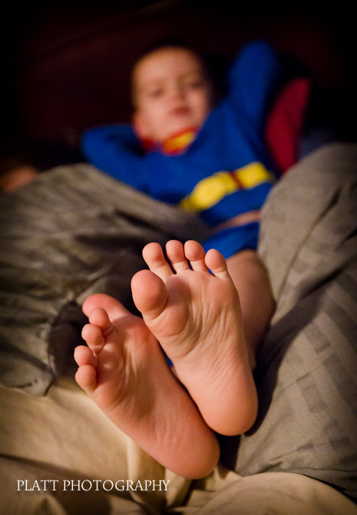
How many feet
do you have?

Slide 4
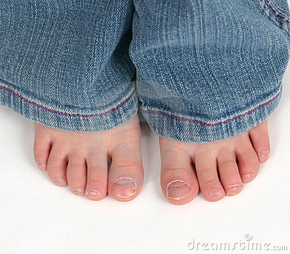
How many toes do you
have on each foot?

Slide 5
What can you do
with your legs and feet?

Slide 6
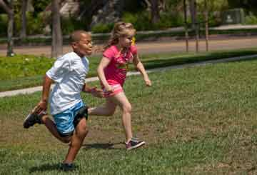
You can use your
legs to run.

Slide 7
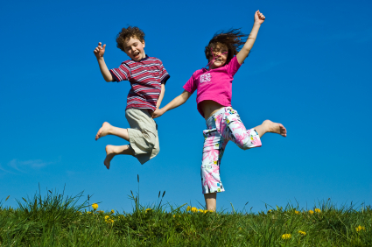
You can use your
legs to jump.

Slide 8
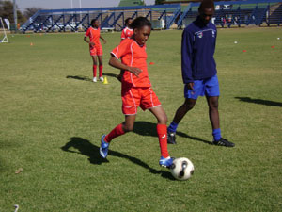
You can use your feet
to kick a ball.

Slide 9
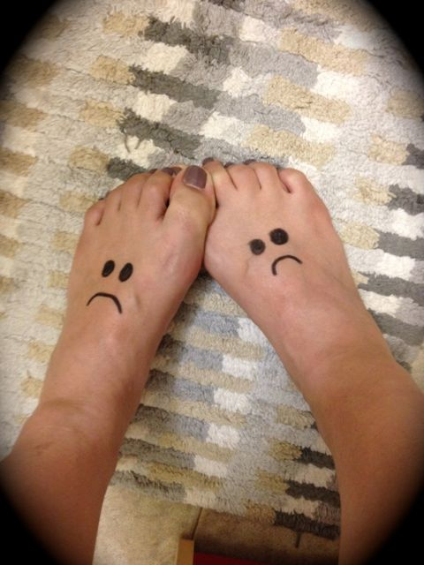
There are times when our
legs and feet can do naughty
things that are not nice.

Slide 10
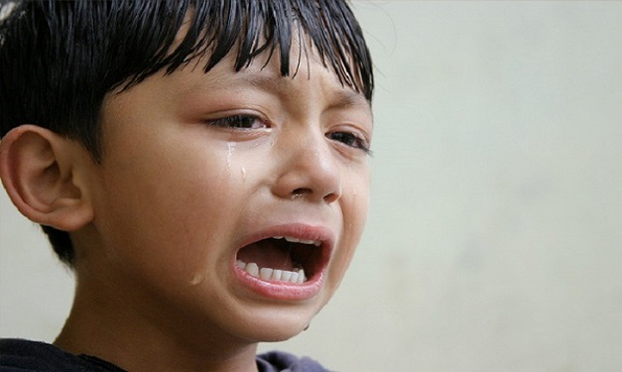
These things can make people sad.
Have you ever made your friend
sad with your legs or feet?

Slide 11
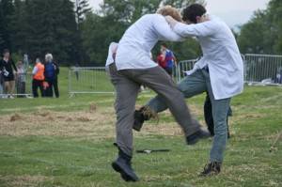
Kicking your friend.

Slide 12
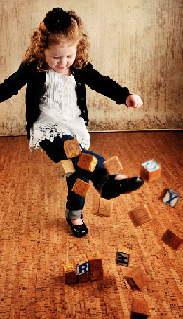
Kicking toys.

Slide 13
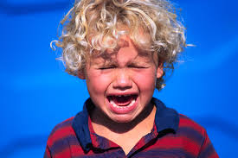
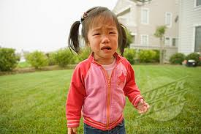

When your legs and feet do naughty things
like this it can make your friends sad.

Slide 14
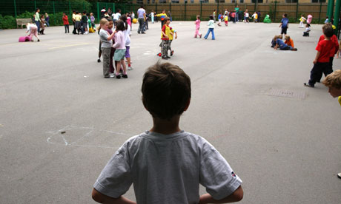
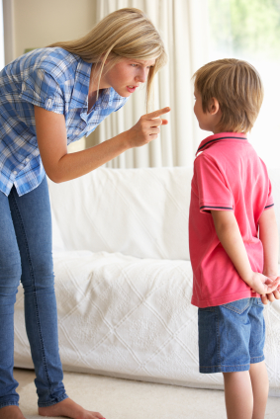
Then you can
get told off.
And your friends
won’t want to
play with you.

Slide 15

So remember to use your legs
and feet for good things.

